Slide 1
High School SAT
File created on: 6/14/2023 2:50:20 PM

Slide 2
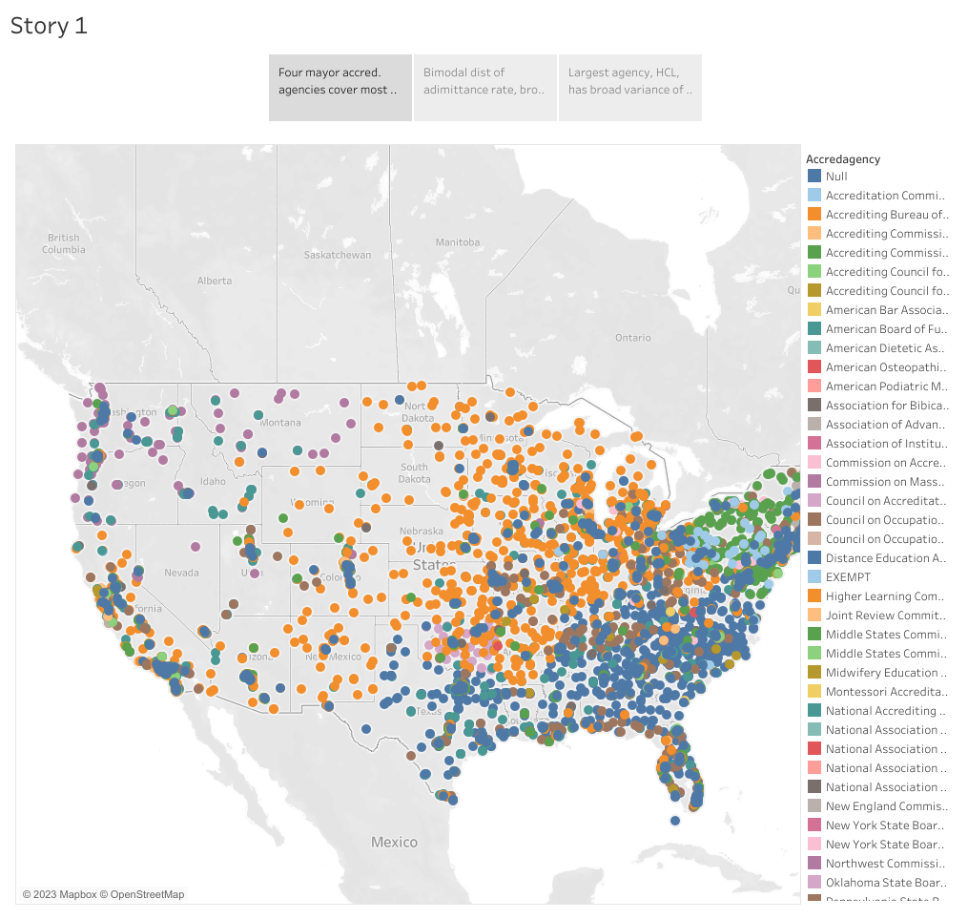

Slide 3
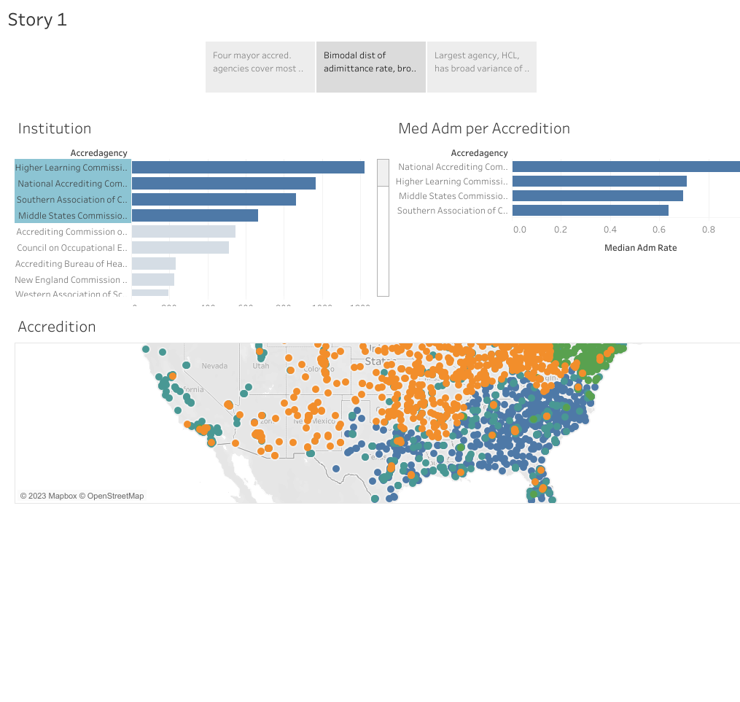

Slide 4
